Slide 1

Multi-level regression models
Felipe Buchbinder

Slide 2

Panel data regression doesn’t have to be about time

Slide 3
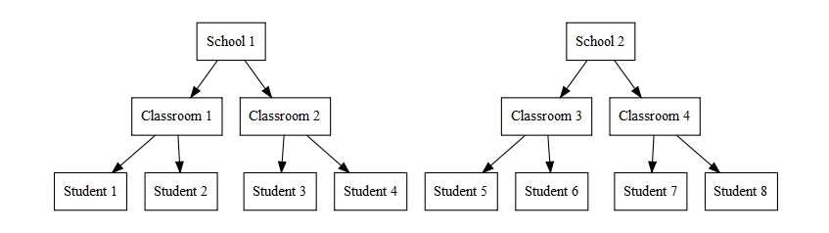
Many relevant problems in social sciences can be tackled with panel data even though they have nothing to do with things changing in time.

Slide 4
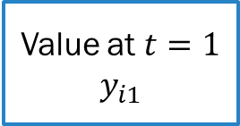
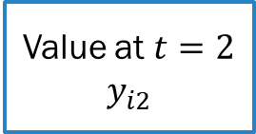
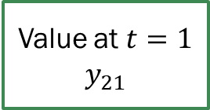
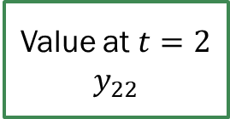
A mental image for panel data (using time)
Many entities. Each entity produces one value for each time period
Entity 1
Entity 2
…
…
Value at $t=1$ $$y_{i1}$$
Value at $t=2$
$$y_{i2}$$
Value at $t=1$ $$y_{21}$$
Value at $t=2$
$$y_{22}$$

Slide 5
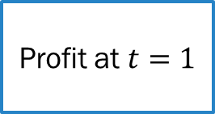
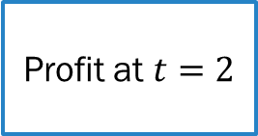
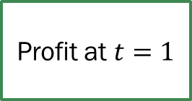
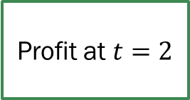
For example… (using time)
Many firms. Each firm produces one value for profit at each quarter
Firm 1
Firm 2
…
…
Profit at $t=1$
Profit at $t=2$
Profit at $t=1$
Profit at $t=2$

Slide 6
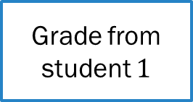
An analogous problem (that doesn’t use time)
Many schools. Each school produces one SAT grade for each student
School 1
Entity 2
…
…
Grade from student $1$
Grade from student 2
Grade from student 1
Grade from student 2

Slide 7
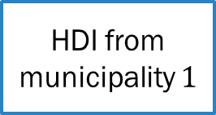
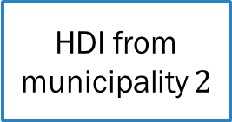
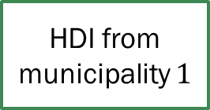
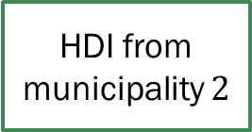
Another analogous problem (that doesn’t use time)
Many states. Each state produces one HDI for each municipality
State 1
State 2
…
…
HDI from municipality $1$
HDI from municipality $2$
HDI from municipality $1$
HDI from municipality $2$

Slide 8
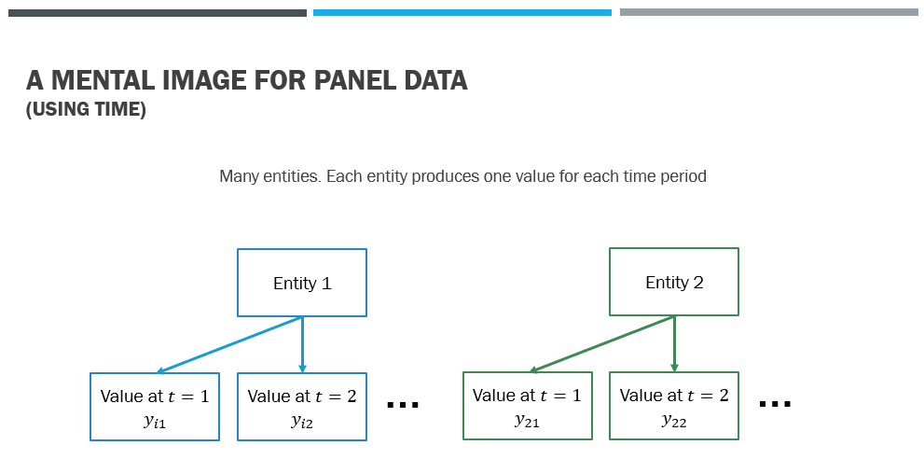
Panel data is analogous to multi-level data where level-1 is time and Level-2 is entity.

Slide 9
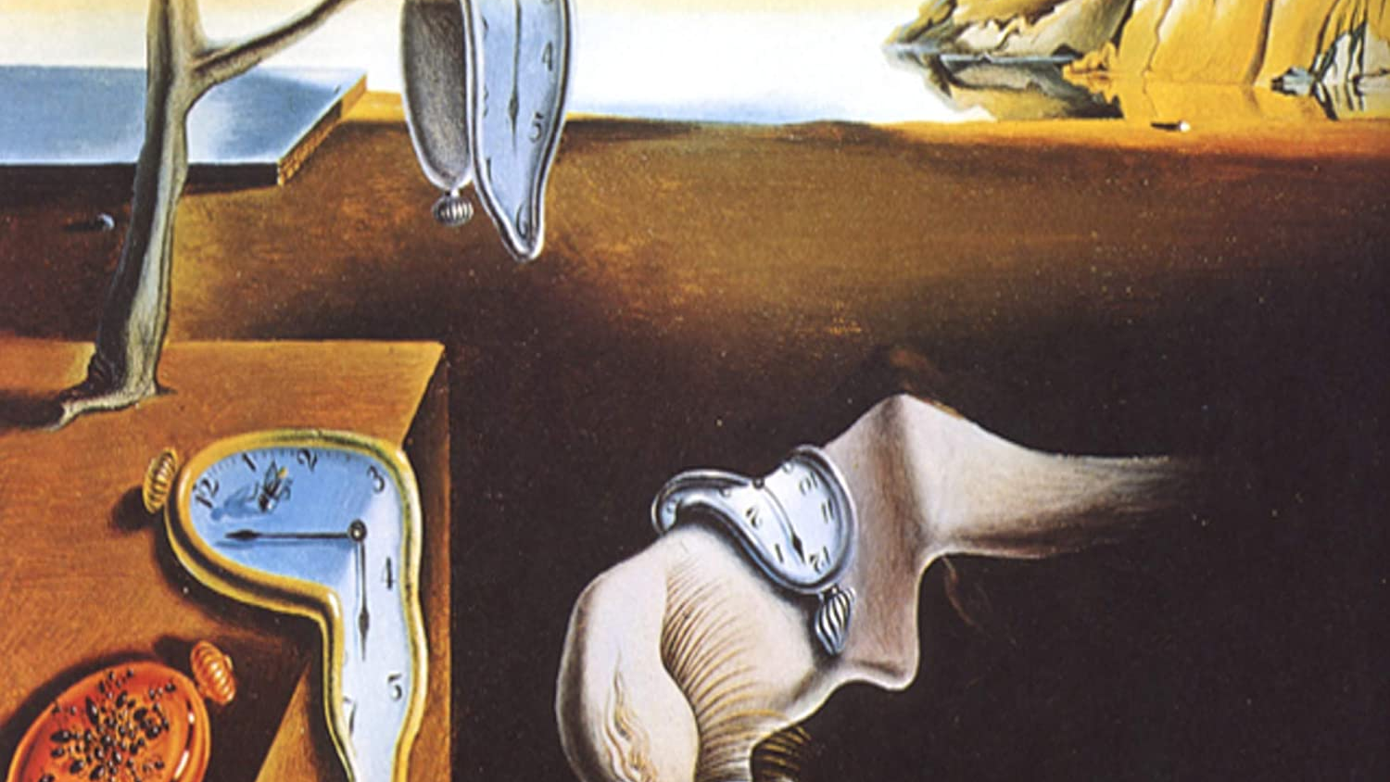
It follows that multi-level data is analogous to panel data… … even though time appears nowhere.

Slide 10
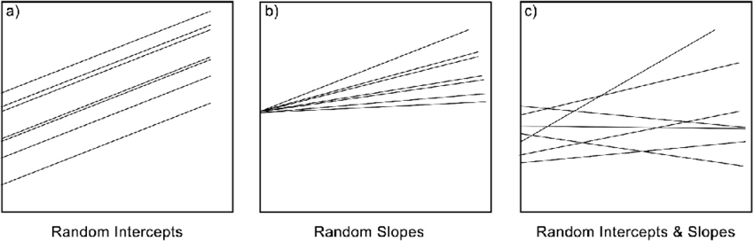
3 types of multi-level regression

Slide 11
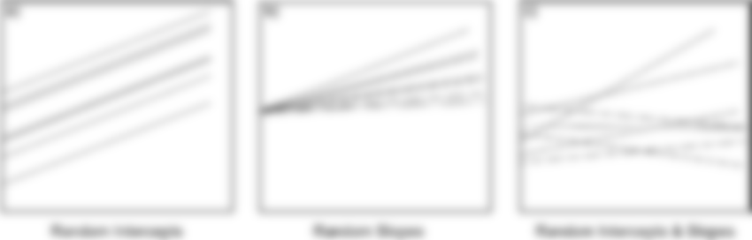
3 types of multi-level regression
Random Intercepts is the most common, so let’s focus on this one.

Slide 12
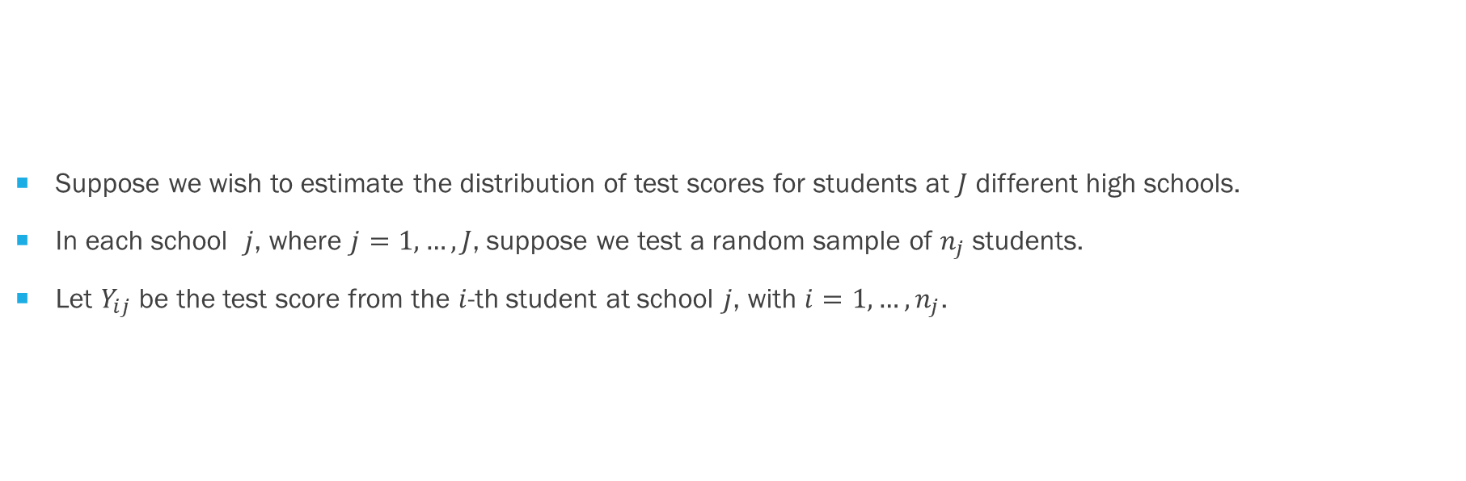
An example will help…
Suppose we wish to estimate the distribution of test scores for students at $J$ different high schools.
In each school $j$, where $j=1,…,J$, suppose we test a random sample of $n_{j}$ students.
Let $Y_{ij}$ be the test score from the $i$-th student at school $j$, with $i=1,…,n_{j}$.

Slide 13

The Random Intercepts model
$$Level 1 equation: Y_{ij}=β_{0j}+β_{1}X_{ij}+η_{ij}$$
$$Level 2 equation: β_{0j}=γ_{0}+γ_{1}Z_{j}+ν_{j}$$

Slide 14


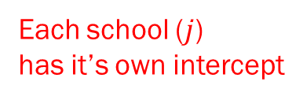
The Random Intercepts model
$$Level 1 equation: Y_{ij}=β_{0j}+β_{1}X_{ij}+η_{ij}$$
$$Level 2 equation: β_{0j}=γ_{0}+γ_{1}Z_{j}+ν_{j}$$
Student’s characteristics
Test score from student $i$ at school $j$
Each school ($j$)
has it’s own intercept
Same slope for all students

Slide 15


The Random Intercepts model
$$Level 1 equation: Y_{ij}=β_{0j}+β_{1}X_{ij}+η_{ij}$$
$$Level 2 equation: β_{0j}=γ_{0}+γ_{1}Z_{j}+ν_{j}$$
School’s characteristics
Intercept of school $j$

Slide 16
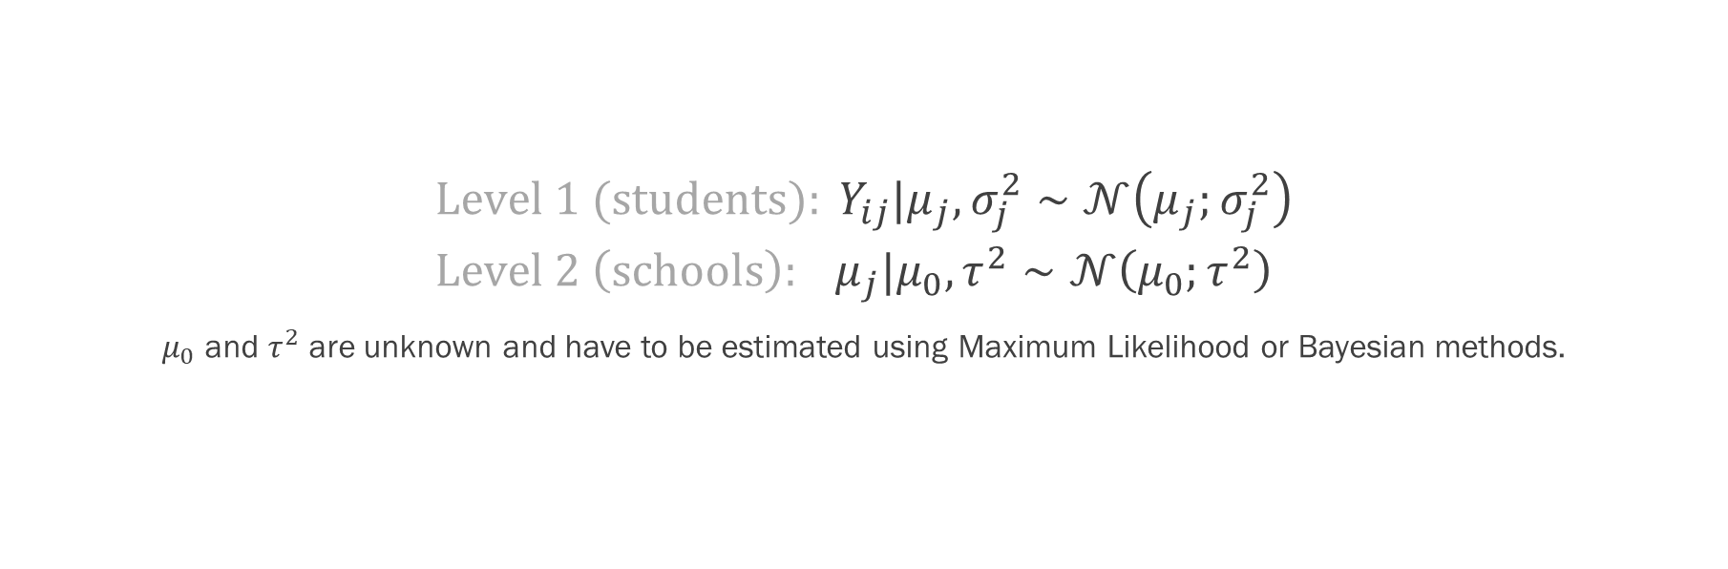
Multi-level regression solves this problem by using a Bayesian approach
$$Level 1 (students): Y_{ij}|μ_{j},σ_{j}^{2}∼𝒩\left(μ_{j};σ_{j}^{2}\right) \\ Level 2 \left(schools\right): μ_{j}|μ_{0},τ^{2}∼𝒩\left(μ_{0};τ^{2}\right)$$
$μ_{0}$ and $τ^{2}$ are unknown and have to be estimated using Maximum Likelihood or Bayesian methods.

Slide 17
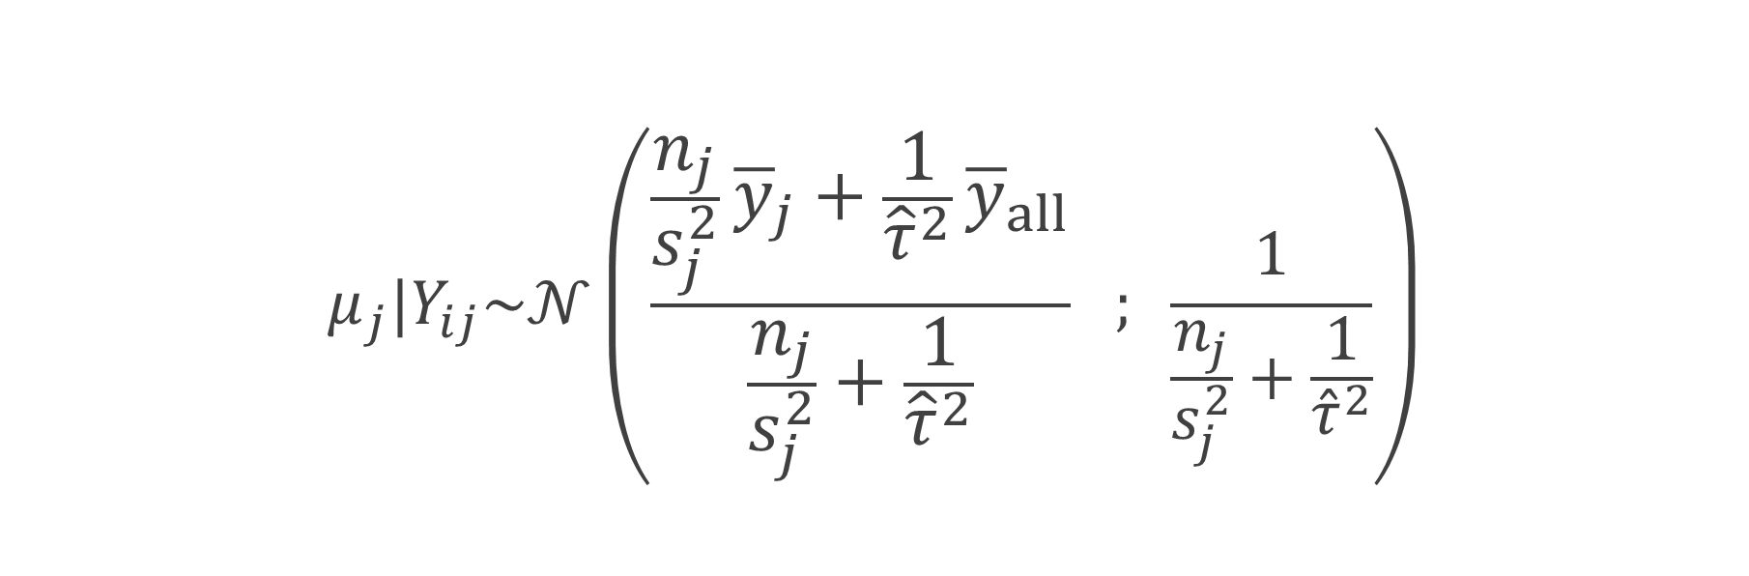
Multi-level regression arrives at the following solution for the effect of each school on student’s grades:
$$μ_{j}|Y_{ij}\sim 𝒩\left(\frac{\frac{n_{j}}{s_{j}^{2}}{\overline{y}}_{j}+\frac{1}{{\hat{τ}}^{2}}{\overline{y}}_{all}}{\frac{n_{j}}{s_{j}^{2}}+\frac{1}{{\hat{τ}}^{2}}} ; \frac{1}{\frac{n_{j}}{s_{j}^{2}}+\frac{1}{{\hat{τ}}^{2}}}\right)$$

Slide 18
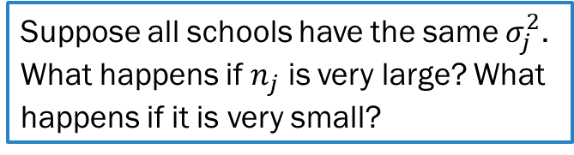
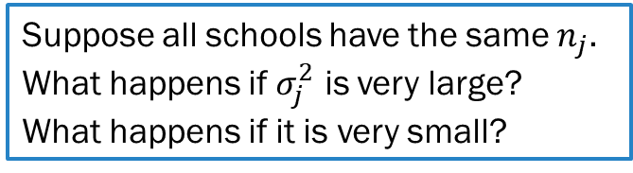
Multi-level regression arrives at the following solution for the effect of each school on student’s grades:
Suppose all schools have the same $σ_{j}^{2}$.
What happens if $n_{j}$ is very large? What happens if it is very small?
Suppose all schools have the same $n_{j}$.
What happens if $σ_{j}^{2}$ is very large?
What happens if it is very small?
$$μ_{j}|Y_{ij}\sim 𝒩\left(\frac{\frac{n_{j}}{s_{j}^{2}}{\overline{y}}_{j}+\frac{1}{{\hat{τ}}^{2}}{\overline{y}}_{all}}{\frac{n_{j}}{s_{j}^{2}}+\frac{1}{{\hat{τ}}^{2}}} ; \frac{1}{\frac{n_{j}}{s_{j}^{2}}+\frac{1}{{\hat{τ}}^{2}}}\right)$$

Slide 19
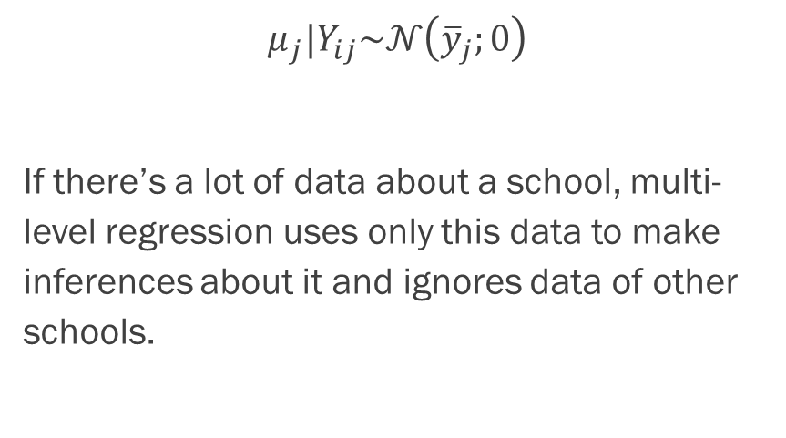

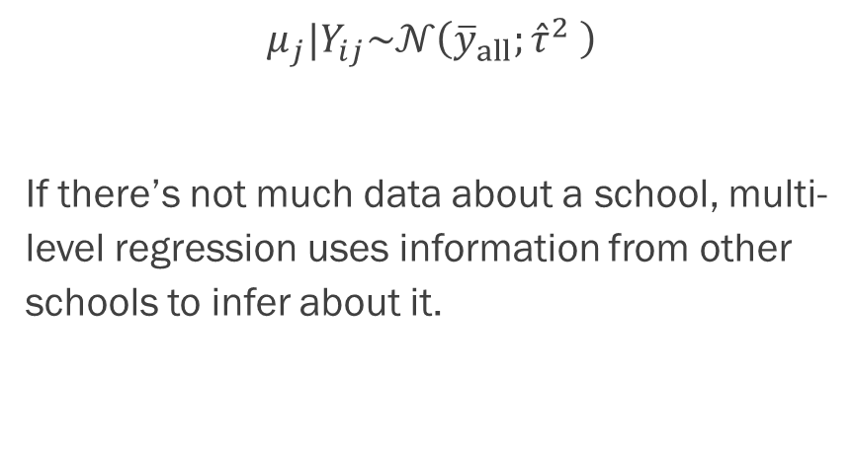

Effects of school size
Large $n_{j}$ ($n_{j}→+∞$)
Small $n_{j}$ ($n_{j}→0$)
$$μ_{j}|Y_{ij}\sim 𝒩\left({\overline{y}}_{j};0\right)$$
If there’s a lot of data about a school, multi-level regression uses only this data to make inferences about it and ignores data of other schools.
$$μ_{j}|Y_{ij}\sim 𝒩\left({\overline{y}}_{all};{\hat{τ}}^{2} \right)$$
If there’s not much data about a school, multi-level regression uses information from other schools to infer about it.

Slide 20
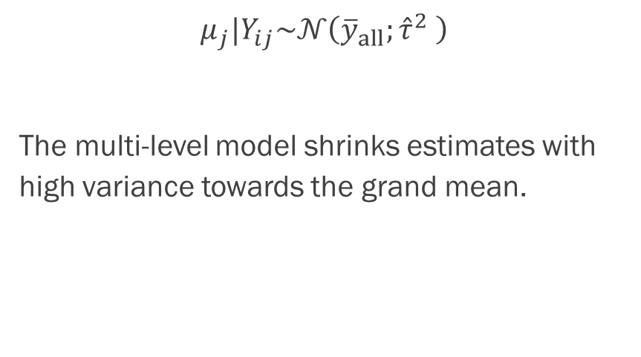



Effects of school heterogeneity
Large $s_{j}^{2}$ ($s_{j}^{2} →+∞$)
Small $s_{j}^{2}$($s_{j}^{2} →0$)
$$μ_{j}|Y_{ij}\sim 𝒩\left({\overline{y}}_{all};{\hat{τ}}^{2} \right)$$
The multi-level model shrinks estimates with high variance towards the grand mean.
$$μ_{j}|Y_{ij}\sim 𝒩\left({\overline{y}}_{j};0\right)$$

Slide 21

Since there’s an analogy between panel data and multi-level data, could I solve this problem using panel data methods?

Slide 22
The Random Intercepts model
$$Level 1 equation: Y_{ij}=β_{0j}+β_{1}X_{ij}+η_{ij}$$
$$Level 2 equation: β_{0j}=γ_{0}+γ_{1}Z_{j}+ν_{j}$$

Slide 23

Extremely advanced & difficult math
$$Level 1 equation: Y_{ij}=β_{0j}+β_{1}X_{ij}+η_{ij}$$
$$Level 2 equation: β_{0j}=γ_{0}+γ_{1}Z_{j}+ν_{j}$$
$$∴$$
$$Y_{ij}=γ_{0}+β_{1}X_{ij}+γ_{1}Z_{j}+ε_{ij}$$

Slide 24
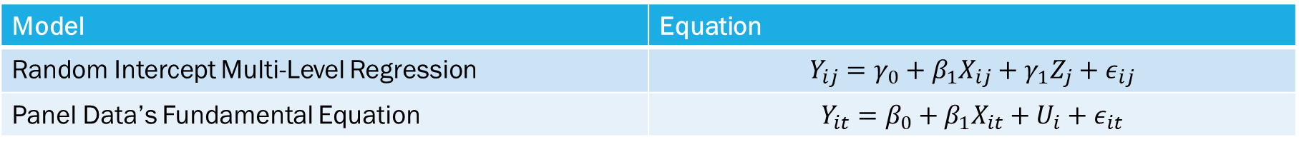
Now, compare…
Model | Equation
Random Intercept Multi-Level Regression | $$Y_{ij}=γ_{0}+β_{1}X_{ij}+γ_{1}Z_{j}+ε_{ij}$$
Panel Data’s Fundamental Equation | $$Y_{it}=β_{0}+β_{1}X_{it}+U_{i}+ε_{it}$$

Slide 25

Challenge question
Is a Multi-Level Random Intercepts model equivalent to a Fixed Effects or to a Random Effects model?

Slide 26

Random effects since both require that characteristics of students and schools be uncorrelated

Slide 27

This makes panel data better than multi-level regression, because if school characteristics do correlate with the error term, we can still use fixed effects and it will work just fine.

